Slide 1
Refresher Mathematics and Statistics in Python

Slide 2
Learning Goals Today
After today you should understand:
1. The difference between descriptive and inferential statistics
2. Measures of center
3. Measures of variation
4. The normal distribution
5. Z-scores

Slide 3
Tools of Statistics:
Descriptive Statistics
Presenting, and describing your data
Inferential Statistics
Drawing conclusions about the world based on a small part (sample) of data.
Goal: Converting data into meaningful information!
Notes:
Descriptive statistics limits itself to what is in your data. Inferential statistics is about what your data implies about the larger population.

Slide 4
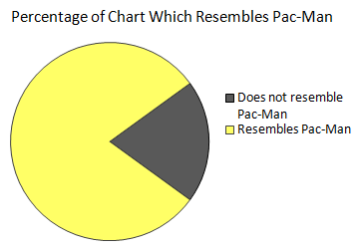
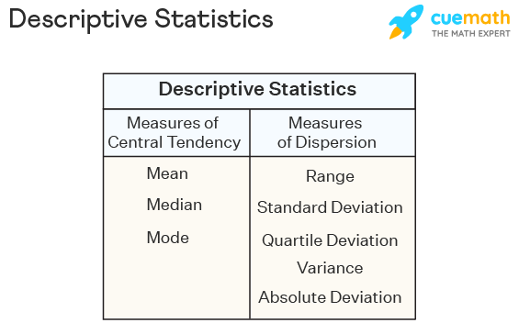
Descriptive Statistics
Presenting Data (e.g. Charts and Graphs)
Describing Data (e.g. Averages, Correlations)
Notes:
Presenting data is taught in Data visualization. Describing data is taught in more disciplines

Slide 5
Inferential Statistics
Inferential statistics = using a small(er) amount of data (sample) to infer information about the larger context (population)
Sample statistics
(known)
Population parameters
(unknown, but can be estimated from sample evidence)
Inference
Notes:
Inferential statistics will be the topic of the next class

Slide 6
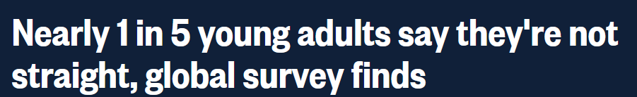
Samples, Populations, and Bias
In order to make good inferences, the sample needs to be representative of the population
https://www.nbcnews.com/feature/nbc-out/nearly-1-5-young-adults-say-they-re-not-straight-n1270003
Notes:
You sometimes see headlines like this making sweeping claims about the whole world. But what are the claims based on?

Slide 7
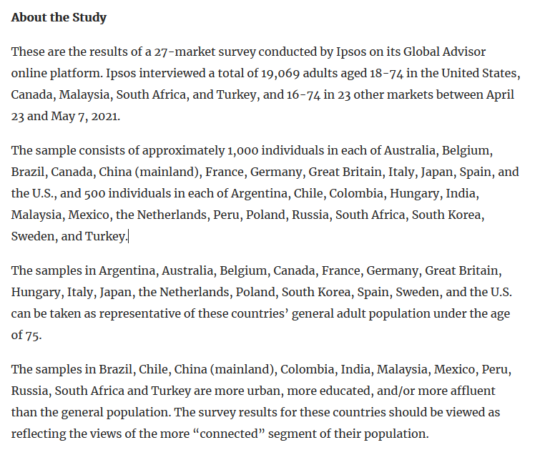
Samples, Populations, and Bias
https://www.ipsos.com/en-us/news-polls/ipsos-lgbt-pride-2021-global-survey
Notes:
If you look at the details of how the data was gathered, you can see that it might actually not be so representative…

Slide 8
Measures of Central Tendency

Slide 9

Mean
The Mean is the same as the (arithmetic) average:
Formula for the Sample mean:
$\overline{x}= \frac{x_{1}+ x_{2}+…+x_{n}}{n}$

Slide 10
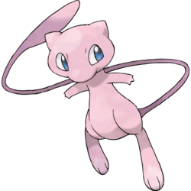

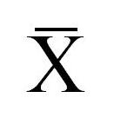
Signs and Symbols
Sample and Population statistics use different symbols so remember:
Population Mean = µ =
Sample Mean = =
Notes:
In case you didn’t know, the name of the pokemon is Mew which is pronounced similarly to Mu.

Slide 11
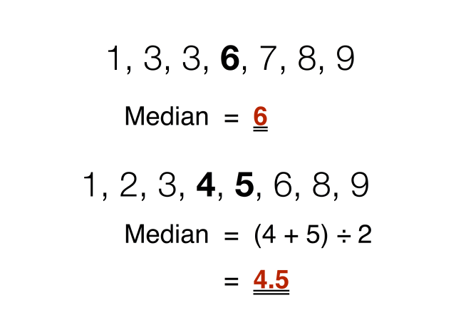
Median
In an Array the median = the number which is exactly in the middle
Array = ordered dataset (usually from lowest to highest)
Image Source: http://www.theinfolist.com/php/SummaryGet.php?FindGo=Median

Slide 12
Mean vs Median
Which one describes the center of your data better?
Answer: Depends on your data!

Slide 13
Outliers
Outliers are values which are much more extreme than the other values
The mean is sensitive to outliers
The median is not sensitive to outliers

Slide 14
Outliers: Effect on the Mean
Outliers influence the Mean!
0 1 2 3 4 5 6 7 8 9 10
0 1 2 3 4 5 6 7 8 9 10
Mean = 3
Mean = 4

Slide 15
Outliers: Effect on the Median
Outliers do not influence the Median!
0 1 2 3 4 5 6 7 8 9 10
0 1 2 3 4 5 6 7 8 9 10
Median = 3
Median = 3

Slide 16
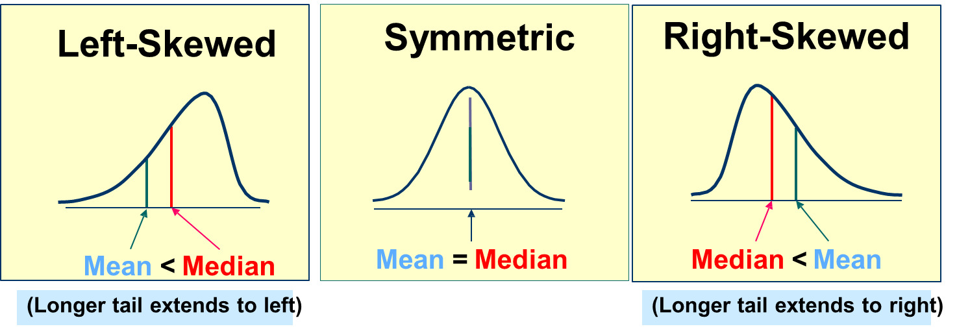
Shape of Distribution
Describes what the data looks like (how it is distributed)
Symmetrical or skewed
Changes the place of the median and mean

Slide 17
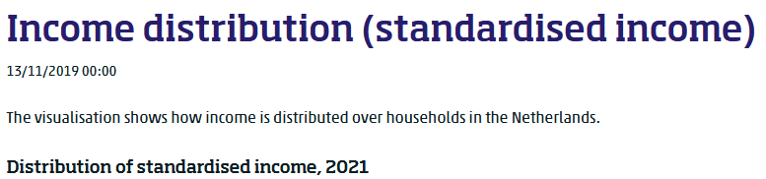
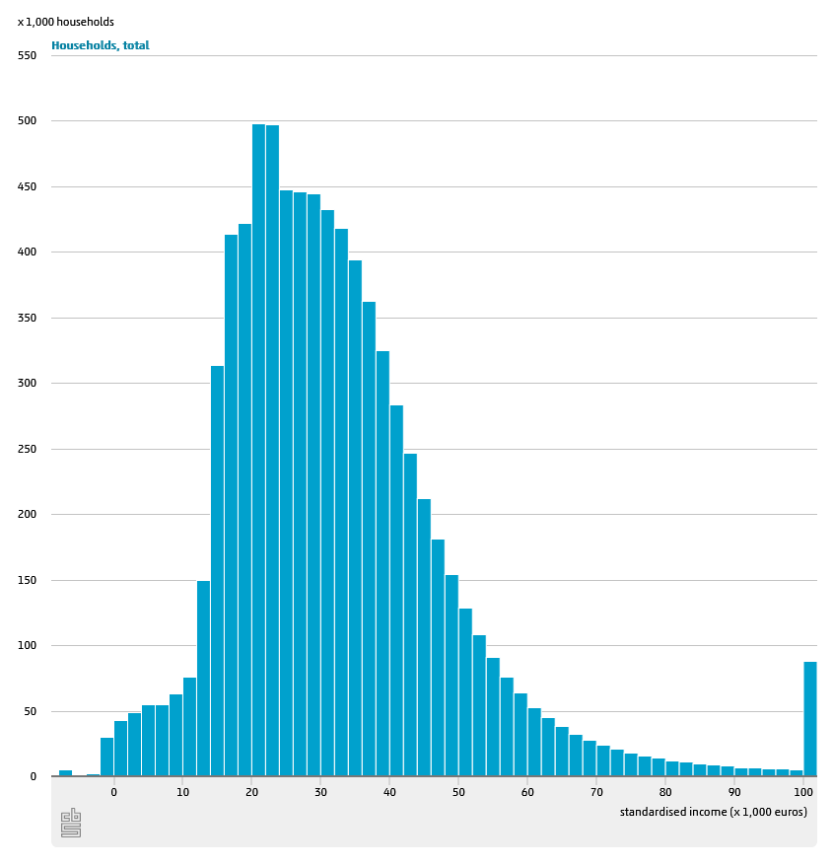
Which Measure to use?
Mean is mostly used
Unless there are extreme outliers, or your data is skewed
Then: Use the median
Example is Income in countries
https://www.cbs.nl/en-gb/visualisations/income-distribution
Notes:
Often for income the median is calculated to describe the “typical” income because it is so skewed and there are many outliers. Confusingly, they often talk about the average while they are actually calculating the median.

Slide 18
Mean and Median in Python
< Screenshot here of how to calculate mean and median in Python >
< The book writes some fancy code, but I would suggest simply using the numpy package >

Slide 19
Exercise 1
Open the file insurance.csv
Calculate the mean and median for the ‘charges’ and ‘bmi’ variables
What do mean and median tell you about the distribution of these variables?
Would you use the mean or median to describe the center of the data?

Slide 20
Exercise 1 Solution
Mean Charges: 13,270
Median Charges: 9,382
So it is right-skewed
Mean BMI: 30.7
Median BMI: 30.4
So it is (mostly) symmetrical
Conclusion: median is better for charges, mean is better for bmi.
<This whole section needs to be made with python code. Preferably also include histograms of the variables>

Slide 21
< I am skipping the mode and the weighted mean because I think the classes will be too full otherwise >

Slide 22
Measures of Variation

Slide 23
Measuring Variation
I ask 7 students how many cups of coffee they drink per day
Student | Cups of coffee
Sofia | 4
Diego | 1
Aisha | 2
Hiroshi | 3
Matilda | 6
Omar | 0
Tim | 5

Slide 24
Measuring Variation Option 1: Range
Simplest measure of variation
→ Difference between the largest and smallest observation
Student | Cups of coffee
Sofia | 4
Diego | 1
Aisha | 2
Hiroshi | 3
Matilda | 6
Omar | 0
Tim | 5
In this case the highest (Matilda’s) – the lowest (Omar’s)
Range = 6-0 = 6

Slide 25
Option 1: Range
Simplest measure of variation
→ Difference between the largest and smallest observation
Range = x_{maximum} – x_{minimum}
0 1 2 3 4 5 6 7 8 9 10 11 12 13 14
Range = 14 - 1 = 13

Slide 26
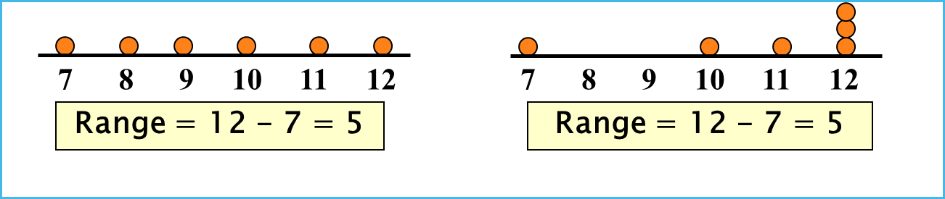
Problems with Range (1)
The range ignores how the data is distributed

Slide 27
Problems with Range (2)
Sensitive to Outliers
1, 1, 1, 1, 1, 1, 1, 1, 1, 1, 1, 2, 2, 2, 2, 2, 2, 2, 2, 3, 3, 3, 3, 4, 5
Range = 5 - 1 = 4
1, 1, 1, 1, 1, 1, 1, 1, 1, 1, 1, 2, 2, 2, 2, 2, 2, 2, 2, 3, 3, 3, 3, 4, 120
Range = 120 - 1 = 119
This number severely distorts the range >:(

Slide 28

Measuring Variation Option 2
Let’s first calculate the mean cups of coffee: $μ= \frac{x_{1}+ x_{2}+…+x_{N}}{N} \text{=} \frac{\sum{x_{i}}}{N}$=
$\frac{4+1+2+3+6+0+5}{7}=3$
So $μ=3$
Student | Cups of coffee
Sofia | 4
Diego | 1
Aisha | 2
Hiroshi | 3
Matilda | 6
Omar | 0
Tim | 5

Slide 29

Measuring Variation Option 2
Difference From the Mean
Now for every student let’s calculate how much higher or lower they scored compared to the mean
In other words: if $x_{i}$ = one person’s amount, and $μ$ = the mean amount, we want to know:
$x_{i}$ - $μ$
Student | Cups of coffee
Sofia | 4
Diego | 1
Aisha | 2
Hiroshi | 3
Matilda | 6
Omar | 0
Tim | 5

Slide 30
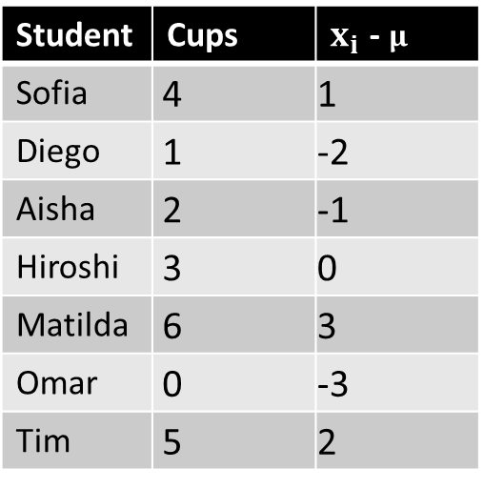

Measuring Variation Option 2
Remember: $μ=$3
So now we have a measurement of variation
Because we measured how the grades vary compared to the mean grade!
Is this a good measurement?
Student | Cups | $x_{i}$ - $μ$
Sofia | 4 | 1
Diego | 1 | -2
Aisha | 2 | -1
Hiroshi | 3 | 0
Matilda | 6 | 3
Omar | 0 | -3
Tim | 5 | 2

Slide 31

Measuring Variation Option 2
There is a big problem though:
If we calculate the average distance from the mean, you would get:
$\frac{3−2−1+0+3−3+2}{7}$ = 0
That doesn’t sound right…
The positives and the negatives cancel each other out!
Student | Cups | $x_{i}$ - $μ$
Sofia | 4 | 1
Diego | 1 | -2
Aisha | 2 | -1
Hiroshi | 3 | 0
Matilda | 6 | 3
Omar | 0 | -3
Tim | 5 | 2

Slide 32

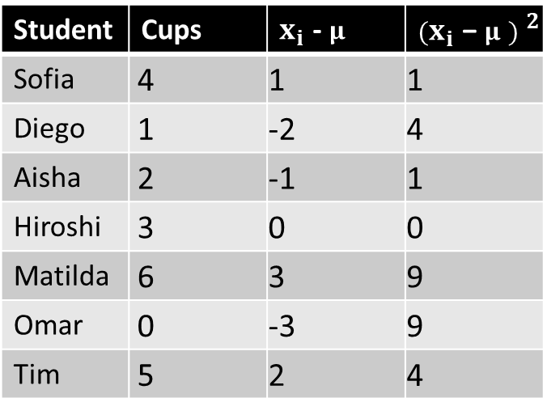
Measuring Variation Option 2
The solution is simple:
If we square all of the differences we make them all positive!
Now let’s calculate the average of all of these squared differences:
$\frac{1+4+1+0+9+9+4}{7}$ = 4
This calculation is called the Variance
Student | Cups | $x_{i}$ - $μ$ | $${(x_{i}\text{ − }μ ) }^{2}$$
Sofia | 4 | 1 | 1
Diego | 1 | -2 | 4
Aisha | 2 | -1 | 1
Hiroshi | 3 | 0 | 0
Matilda | 6 | 3 | 9
Omar | 0 | -3 | 9
Tim | 5 | 2 | 4

Slide 33

Variance
So the variance is a useful measure
We give it this symbol: $σ^{2}$
The formula is this: $σ^{2}= \frac{\sum{{(x_{i} −μ)}^{2}}}{N}$

Slide 34
Variance
The problem though is that the numbers are still squared.
So… we now have a measurement of the squared variation
This makes it hard to interpret
Solution: Take the Square Root of the Variance

Slide 35

$$\sqrt{σ^{2}}= σ$$
$σ$ = Standard Deviation

Slide 36
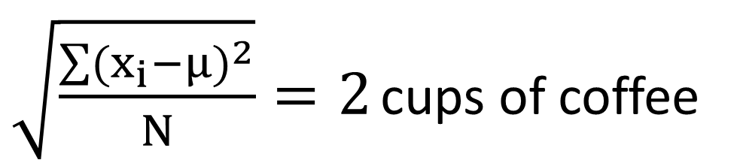
Measuring Variation Option 2
So finally the standard deviation:
Student | Cups | $x_{i}$ - $μ$ | $${(x_{i}\text{ − }μ ) }^{2}$$
Sofia | 4 | 1 | 1
Diego | 1 | -2 | 4
Aisha | 2 | -1 | 1
Hiroshi | 3 | 0 | 0
Matilda | 6 | 3 | 9
Omar | 0 | -3 | 9
Tim | 5 | 2 | 4
$\sqrt{\frac{\sum{{(x_{i}−μ)}^{2}}}{N}}=2$ cups of coffee

Slide 37
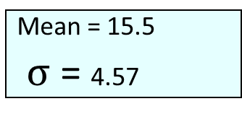
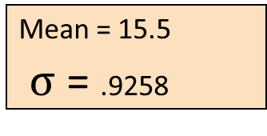
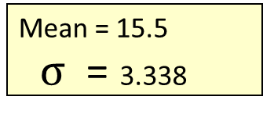
Comparing Standard Deviations
Same mean, but different standard deviations:
→ Bigger Average Spread = Higher Standard Deviation
Data A
Mean = 15.5
$σ$ = 3.338
11 12 13 14 15 16 17 18 19 20 21
Data B
Mean = 15.5
$σ$ = .9258
11 12 13 14 15 16 17 18 19 20 21
Data C
Mean = 15.5
$σ$ = 4.57
11 12 13 14 15 16 17 18 19 20 21

Slide 38
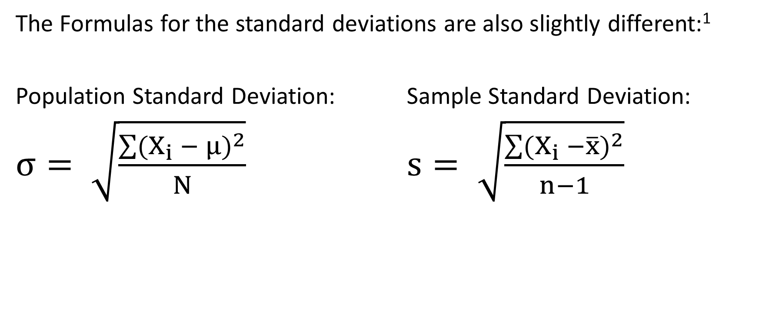
Population and Sample Standard Deviation
The Formulas for the standard deviations are also slightly different:¹
Population Standard Deviation: Sample Standard Deviation:
$σ= \sqrt{\frac{\sum{{(X_{i} − μ)}^{2}}}{N}}$ $s= \sqrt{\frac{\sum{{(X_{i} −\overline{x})}^{2}}}{n−1}}$

Slide 39
Coefficient of Variation
What if you want to compare the distribution of two pieces of data?
But the data is not measured in the same units (e.g. height and weight)?
Or it does not have the same mean?
Answer: Use Coefficient of Variation
This shows relative variation to the mean

Slide 40
Coefficient of Variation
The Coefficient of Variation (CV) measure relative variation
Variation relative to the mean
Expressed in percentage
Population Sample

Slide 41
Coefficient of Variation
Stock A:
Average price last year = $50
Standard deviation = $5
Stock B:
Average price last year = $100
Standard deviation = $5
Both stocks have the same standard deviation, but stock B is less variable relative to its price

Slide 42
Exercise 2
Open the file insurance.csv again
Calculate the coefficient of variation for age and bmi
Which of the two shows more variation?

Slide 43
Exercise 2 solution
< Again I wouldn’t use the script of the book, just use the std function in the numpy package >
CV age = 35.8%
CV bmi = 19.9%
So age shows more variation

Slide 44
The Normal Distribution

Slide 45
Normal Distribution
Last week we discussed the Binomial Distribution
Another very common distribution used to calculate probabilities is the
Normal Distribution

Slide 46
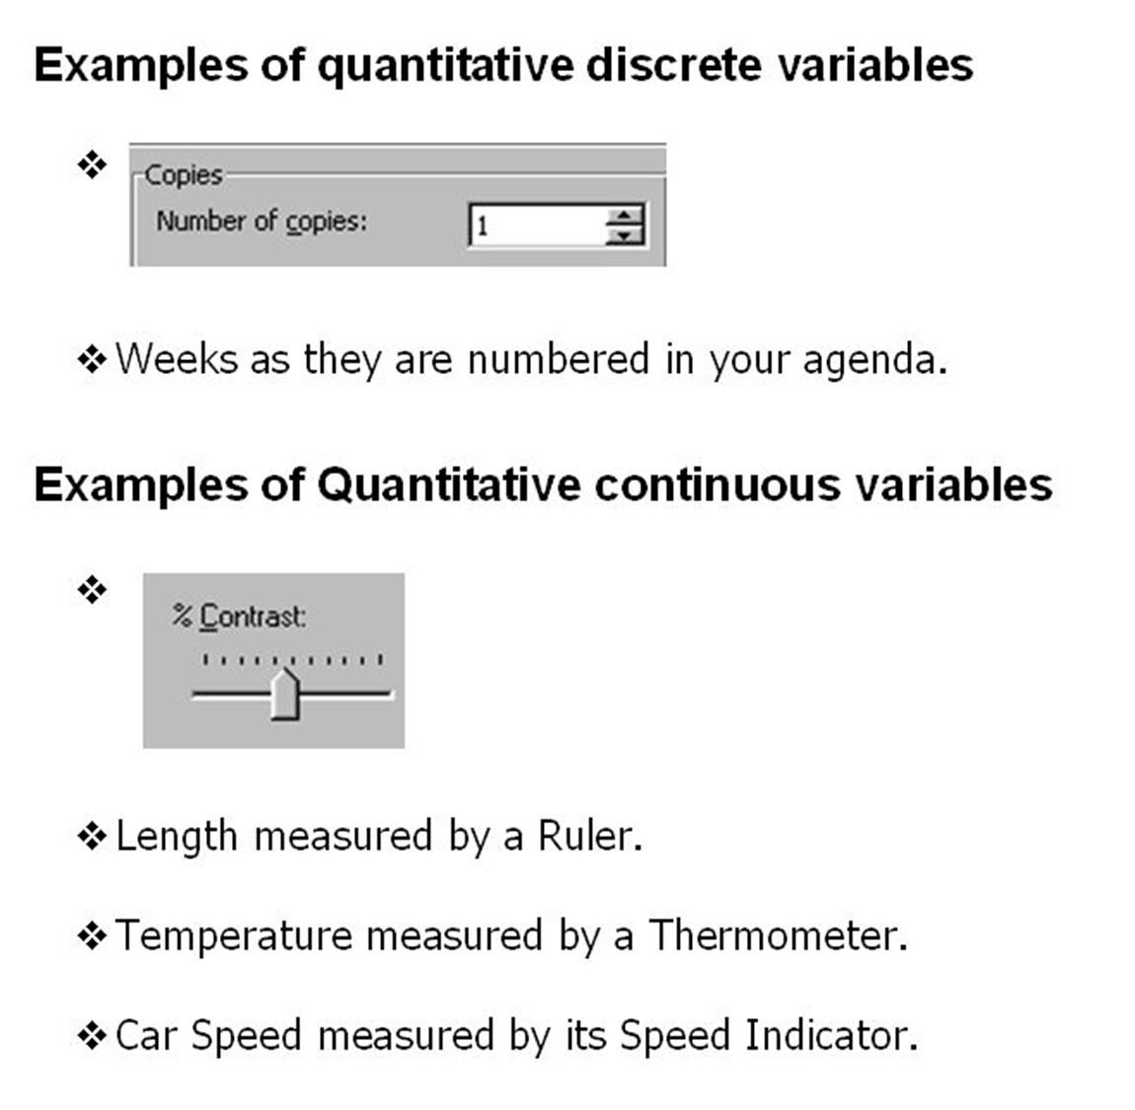
Continuous Random Variable
If we go back:
Discrete Variable = countable
Continuous = uncountable
Discrete → Binomial Distributions
Continuous → Normal Distributions

Slide 47
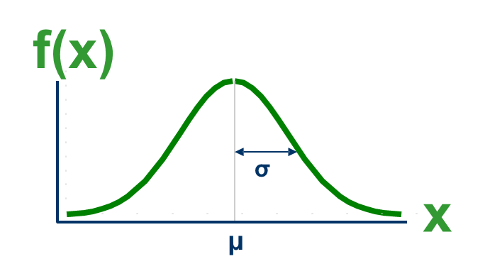
Normal Distributions
Parameters
µ = Mean (Mu)
σ = Standard Deviation (Sigma)

Slide 48
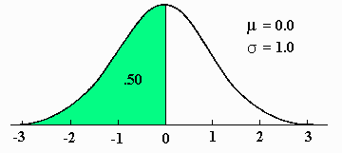
Normal Distributions
When using the normal distribution to calculate probability we have to assume that it is:
Bell-Shaped
Symmetrical (Mean = Median)
Image Source: http://www.psychstat.missouristate.edu/introbook/sbk11m.htm

Slide 49
Probabilities in Normal Distributions
With a normal distribution we cannot find “points” but can only find “areas”
→ Probability is measured with the area
f(x)
P (a ≤ x ≤ b)
a
b
x
P (a $≤$ x $≤$ b) is math language for “The probability that it is in between a and b”

Slide 50
Example
We have a population of adult women with:
Mean height = 170 cm
Standard Deviation = 7 cm
What is P(x < 165 cm)?
What is P (165 < x < 170)?
How tall are the tallest 10% of the population?

Slide 51
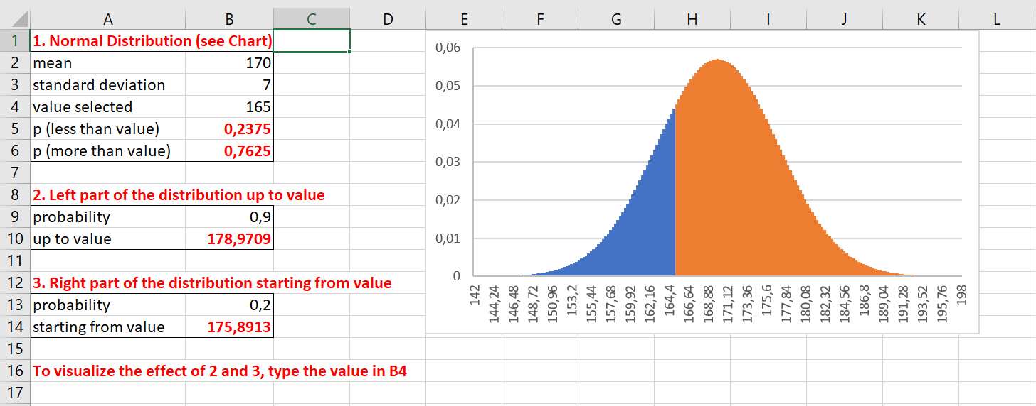
Solution: Use PQRS!
a. p(x < 165) = 0.2375
Notes:
These still need to be adapted to python

Slide 52
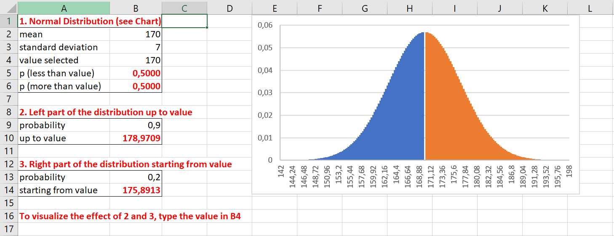
PQRS
b. P (165 < x < 170) = 0.2625
= P(x < 170) – P(x < 165) = 0.5 – 0.2375 = 0.2625
Notes:
These still need to be adapted to python

Slide 53
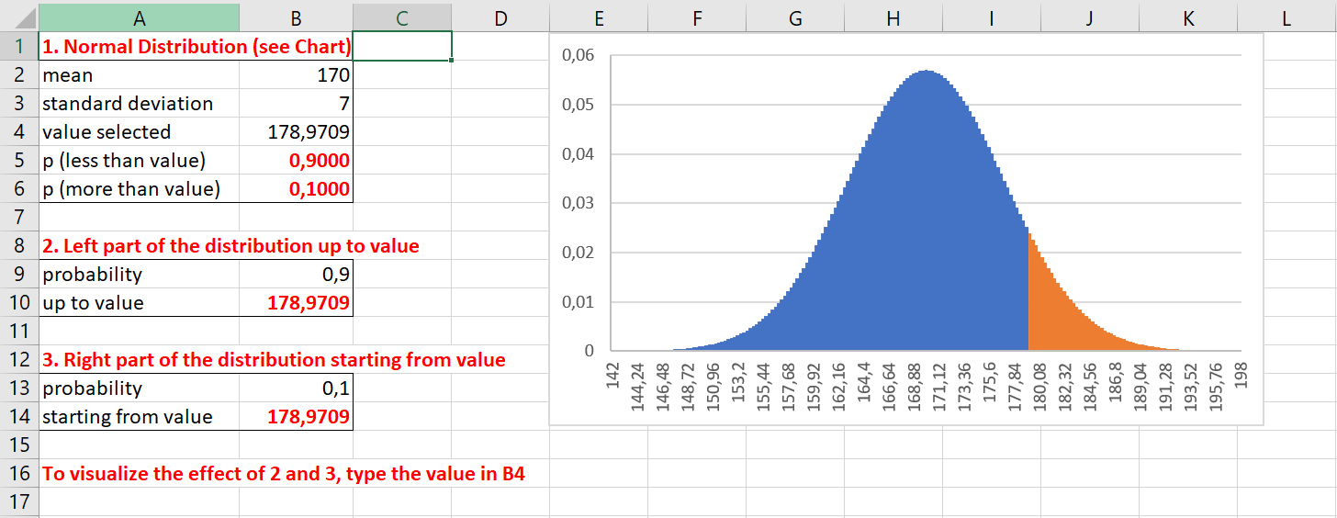
PQRS
c. tallest 10% = 178.97 cm or taller
Notes:
These still need to be adapted to python

Slide 54
Final Exercise
In file insurance.csv, the variable bmi follows an approximate normal distribution. This means we can use the normal distribution to model the bmi of new patients.
Based on this data and the normal distribution, calculate the probability that:
A new patient is underweight (bmi < 18.5)
A new patient has a normal weight (bmi in between 18.5 and 25)
What BMI does a patient need to have to be in the top 20%?

Slide 55
Final Exercise Solutions
1. P(X<18.5) = 0.0230
2. P(18.5 < x < 25) = P(x<25) – P(x<18.5) = 0.1535
3. 35.8
Notes:
Still need to do this in Python

